Slide 1

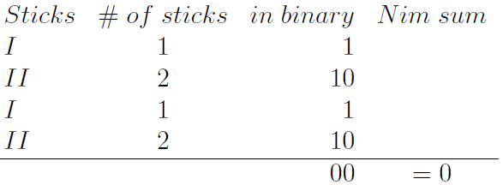
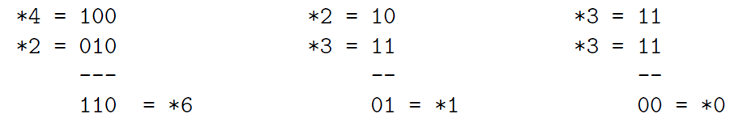
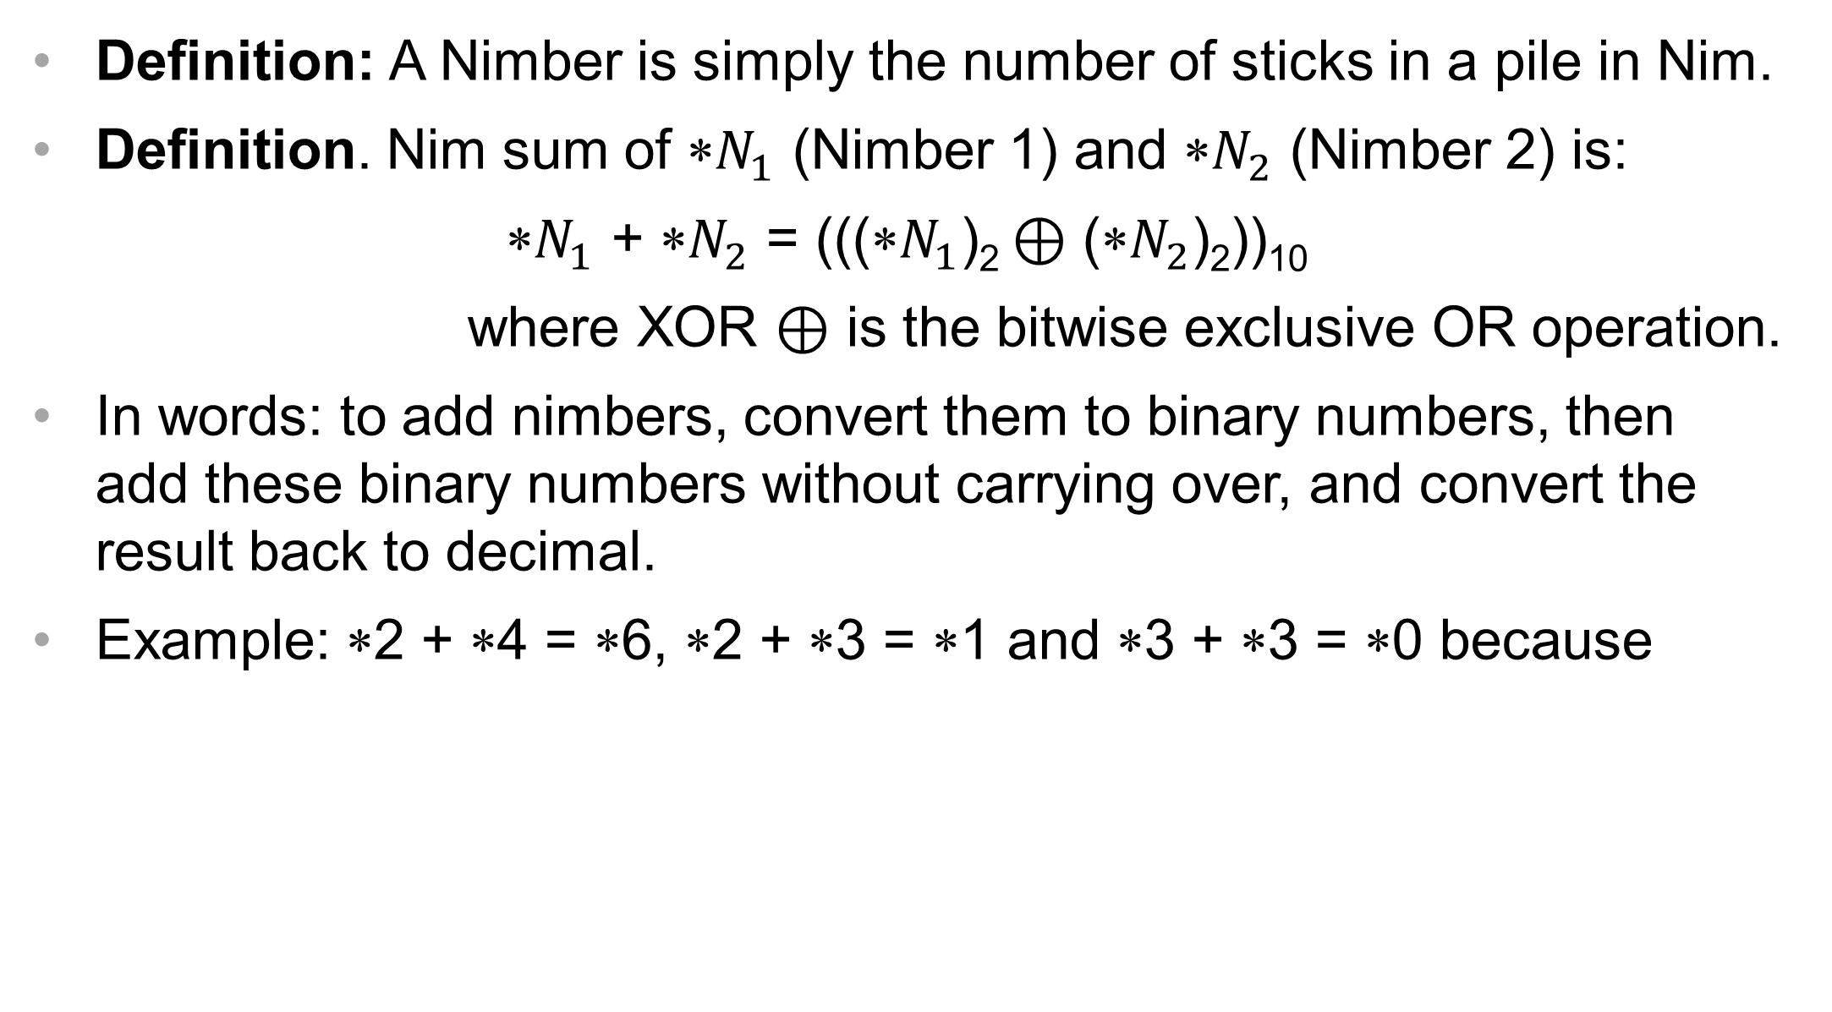
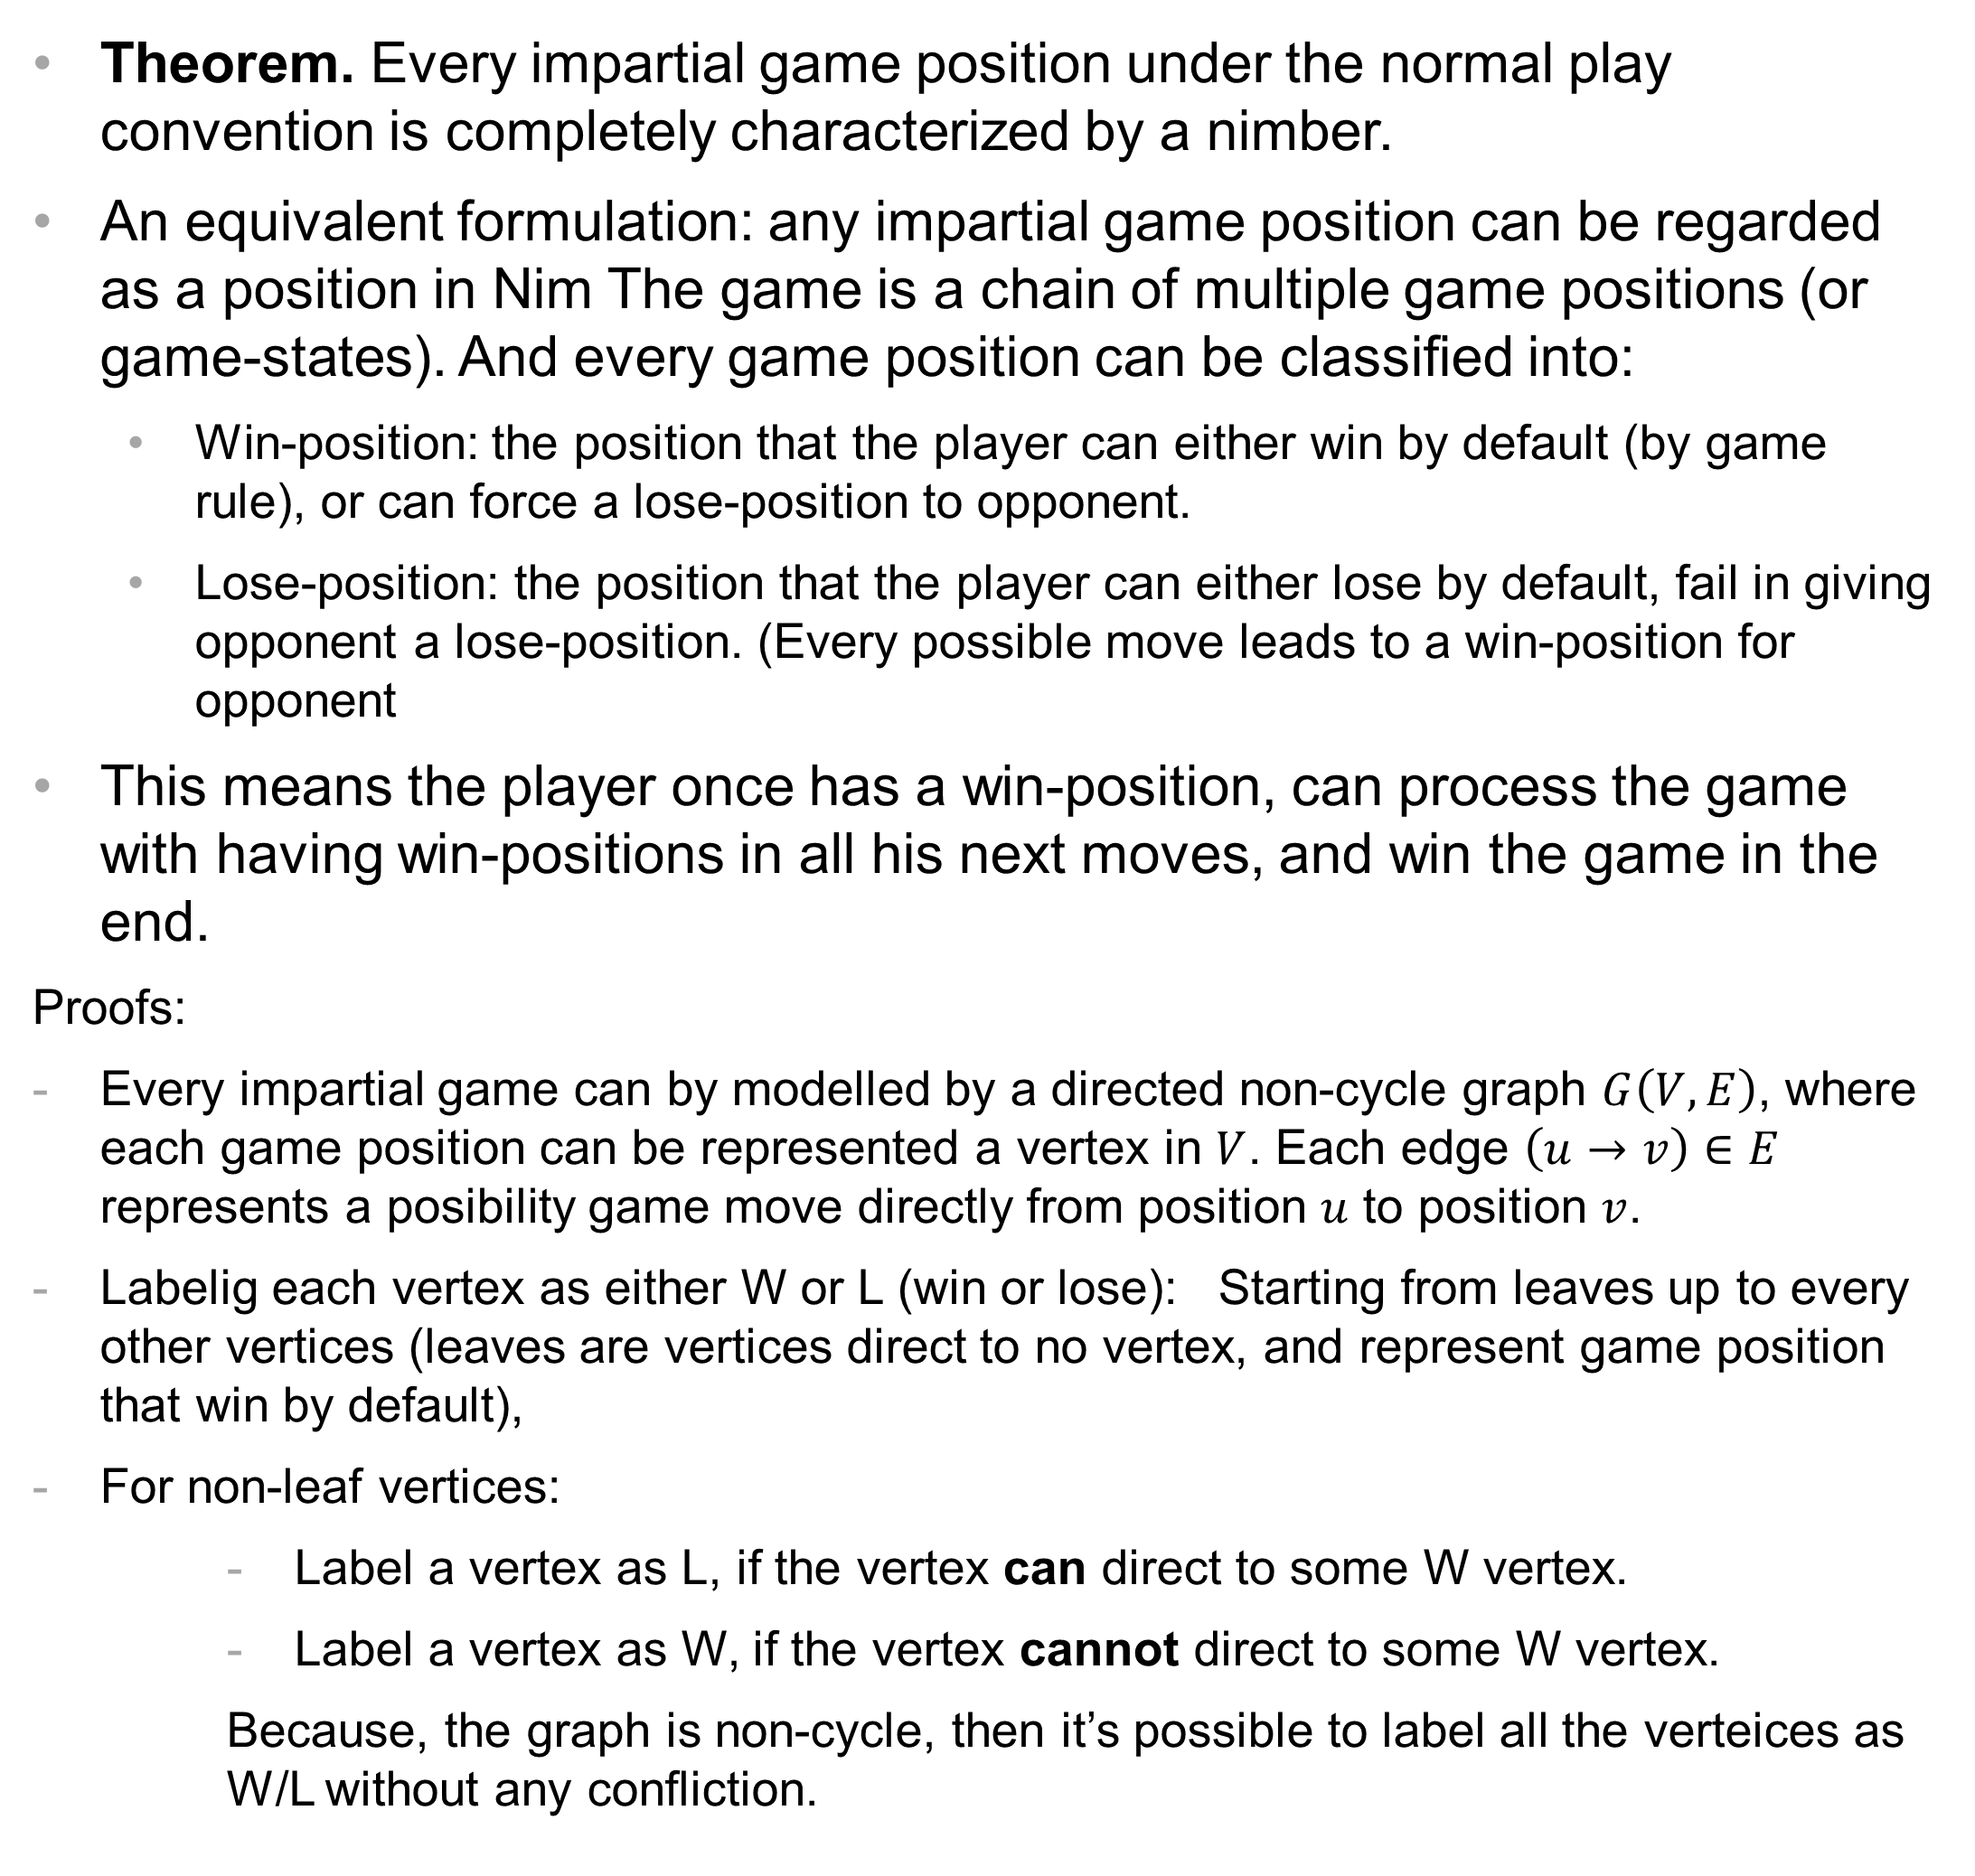
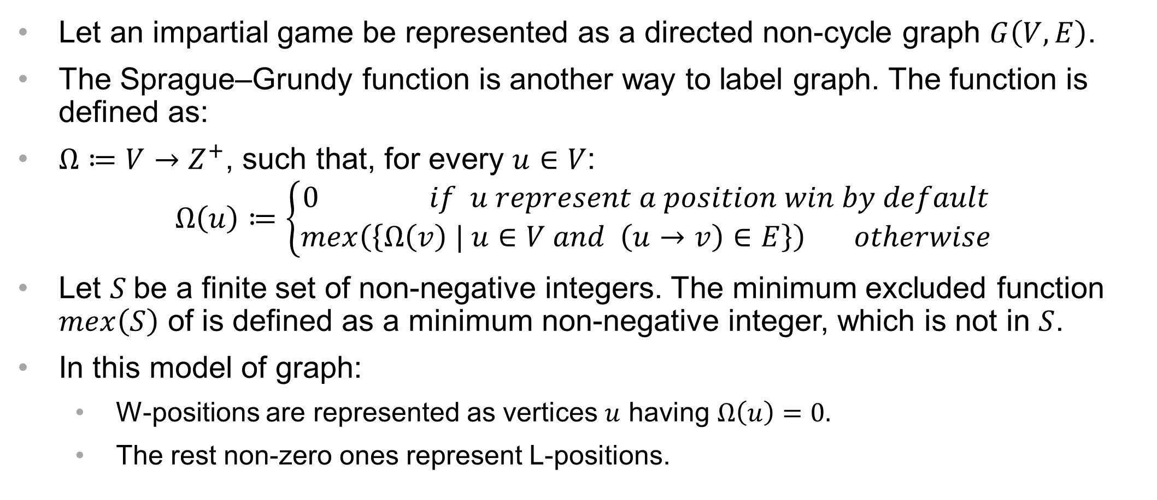
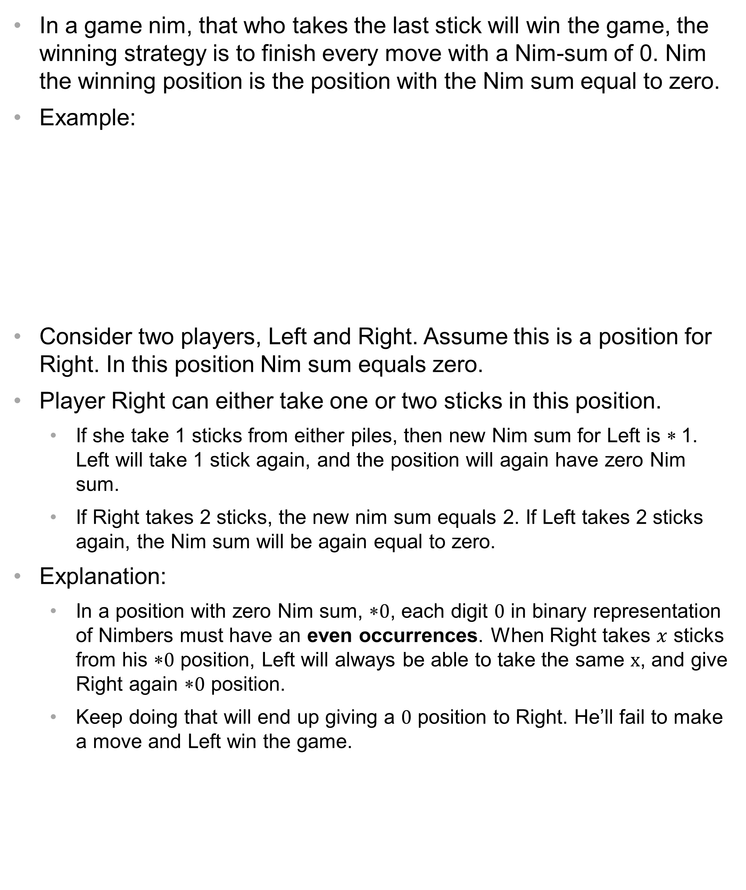
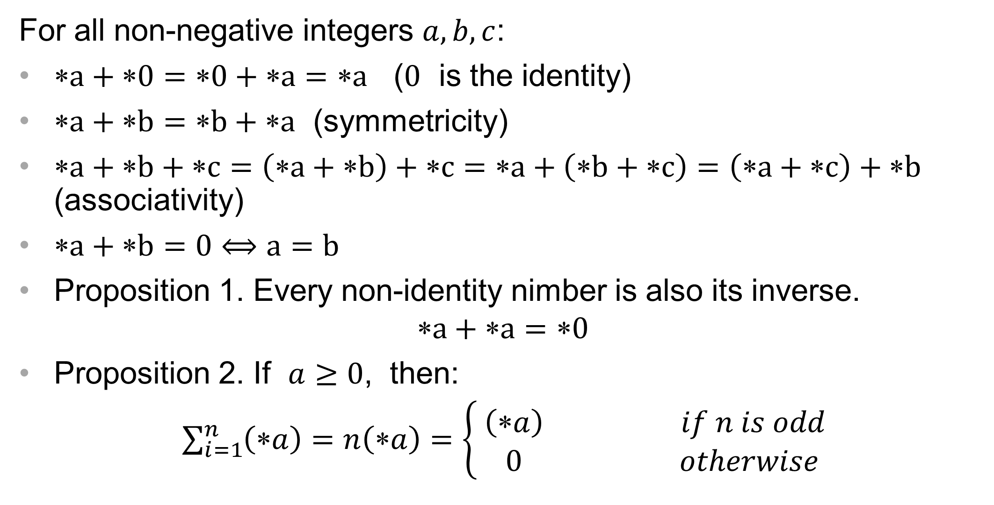
GAME NIM TO EVERY IMPARTIAL GAME
Quan Tran | Dr. Andrei Olifer | GEORGIA GWINNETT COLLEGE
OBJECTIVES
PROPERTIES OF NIMBER ADDITION
SPRAGUE–GRUNDY THEOREM
Introduce the game Nim and, nimber - the strategy to play Nim.
Sprague–Grundy theorem: “Every impartial game can be converted to the gameplay of nim”
For all non-negative integers $a,b,c$:
$a+0=0+a=a$ ($0$ is the identity)
$a+b=b+a$ (symmetricity)
$a+b+c=\left(a+b\right)+c=a+\left(b+c\right)=\left(a+c\right)+b$ (associativity)
$a+b=0⟺a=b$
Proposition 1. Every non-identity nimber is also its inverse.
$$a+a=0$$
Proposition 2. If $a≥0$, then:
$\sum_{i=1}^{n}{\left(∗a\right)}=n\left(∗a\right)=\left\{\begin{aligned}\left(a\right) if n is odd \\ 0 otherwise \end{aligned}\right.$
Theorem. Every impartial game position under the normal play convention is completely characterized by a nimber.
An equivalent formulation: any impartial game position can be regarded as a position in Nim The game is a chain of multiple game positions (or game-states). And every game position can be classified into:
Win-position: the position that the player can either win by default (by game rule), or can force a lose-position to opponent.
Lose-position: the position that the player can either lose by default, fail in giving opponent a lose-position. (Every possible move leads to a win-position for opponent
This means the player once has a win-position, can process the game with having win-positions in all his next moves, and win the game in the end.
Proofs:
Every impartial game can by modelled by a directed non-cycle graph $G\left(V,E\right)$, where each game position can be represented a vertex in $V$. Each edge $\left(u→v\right)∈E$ represents a posibility game move directly from position $u$ to position $v$.
Labelig each vertex as either W or L (win or lose): Starting from leaves up to every other vertices (leaves are vertices direct to no vertex, and represent game position that win by default),
For non-leaf vertices:
Label a vertex as L, if the vertex can direct to some W vertex.
Label a vertex as W, if the vertex cannot direct to some W vertex.
Because, the graph is non-cycle, then it’s possible to label all the verteices as W/L without any confliction.
Impartial game and NIM
Definition: Impartial game is a game in which the allowable moves depend only on the position and not on which of the two players is currently moving, and where the payoffs are symmetric. Nim is an example of an impartial game.
In Nim, two player take turns removing objects from distinct heaps. On each turn, a player must remove at least one object, and may remove any number of objects provided they all come from the same heap. The player who is not able to make a move loses the game.
An example of a position in Nim:
I
I I
I I I I
I I
with a pile of one stick, two piles of two, and a pile of four sticks.
WINNING STRATETGY IN NIM
In a game nim, that who takes the last stick will win the game, the winning strategy is to finish every move with a Nim-sum of 0. Nim the winning position is the position with the Nim sum equal to zero.
Example:
Consider two players, Left and Right. Assume this is a position for Right. In this position Nim sum equals zero.
Player Right can either take one or two sticks in this position.
If she take 1 sticks from either piles, then new Nim sum for Left is $$1. Left will take 1 stick again, and the position will again have zero Nim sum.
If Right takes 2 sticks, the new nim sum equals 2. If Left takes 2 sticks again, the Nim sum will be again equal to zero.
Explanation:
In a position with zero Nim sum, $0$, each digit $0$ in binary representation of Nimbers must have an even occurrences. When Right takes $x$ sticks from his $0$ position, Left will always be able to take the same $x$, and give Right again $0$ position.
Keep doing that will end up giving a $0$ position to Right. He’ll fail to make a move and Left win the game.
SPRAGUE–GRUNDY FUNCTION
Let an impartial game be represented as a directed non-cycle graph $G\left(V,E\right)$.
The Sprague–Grundy function is another way to label graph. The function is defined as:
$Ω≔V→Z^{+}$, such that, for every $u∈V$:
$$Ω\left(u\right)≔\left\{\begin{aligned}0 if u represent a position win by default \\ mex\left(\left\{Ω\left(v\right) | u∈V and \left(u→v\right)∈E\right\}\right) otherwise\end{aligned}\right.$$
Let $S$be a finite set of non-negative integers. The minimum excluded function $mex\left(S\right)$ of is defined as a minimum non-negative integer, which is not in $S$.
In this model of graph:
W-positions are represented as vertices $u$ having $Ω\left(u\right)=0.$
The rest non-zero ones represent L-positions.
NIMBER
Definition: A Nimber is simply the number of sticks in a pile in Nim.
Definition. Nim sum of ∗$N_{1}$ (Nimber 1) and ∗$N_{2}$ (Nimber 2) is:
∗$N_{1}$ + ∗$N_{2}$ = (((∗$N_{1}$)₂ ⊕ (∗$N_{2}$)₂))₁₀
where XOR ⊕ is the bitwise exclusive OR operation.
In words: to add nimbers, convert them to binary numbers, then add these binary numbers without carrying over, and convert the result back to decimal.
Example: ∗2 + ∗4 = ∗6, ∗2 + ∗3 = ∗1 and ∗3 + ∗3 = ∗0 because
REFERENCES
Brit C. A. Milvang-Jensen
“Combinatorial Games, Theory and applications” Thesis
IT University of Copenhagen, 2000

